Slide 1
Georgia STEM Incubator
GOSA Requested Changes: May 14, 2015
GOSA Contacts:
Adrian Neely, aneely@georgia.gov
Amechi Okoh, aokoh@georiga.gov
Status Update: May 20, 2015
Final Deliverable: May 29, 2015

Slide 2

Discover and Connect to STEM resources, partners, and innovative initiatives through the Georgia Stem Incubator.
Georgia STEM Incubator
(Place logo here)
Login:
Register
Forgot Password?
Search this site…
Rotating Stock Photos & Georgia-Specific Photos
The movement to advance STEM education in Georgia is gaining momentum. The mission of the Georgia STEM Incubator) is to spur innovation in STEM education through reflective instructional practices, professional learning, and collaboration. Discover and connect to STEM resources and partners throughout the state.
Resources
Become a STEM Certified Schools
Partners
Learn More
Learn More
Learn More
Site Map Funded By Terms
Accessibility Sponsors Privacy Policy
Notes:
Option 1

Slide 3
1.12 User Registration
Educators
Partners
Include dropdown menu items: district, and grade band (primary, elementary, middle, high school, post-secondary)
Business Name
Services Provided
Organization Type
Region
Subject Area Focus
Group Served

Slide 4
1.12 Business/Partner Registration
Business Interest in STEM Schools
If your business/industry is interested in working with Georgia STEM Schools, please complete this form and we will connect you with a school who would appreciate the expertise of business/industry as they work towards STEMSlide 2: Discover and Connect to STEM resources, partners, and innovative initiatives through the Georgia Stem Incubator. Certification.
*Required
  Name of your business/industry
  Contact Person
  Contact Person's Email
  Contact Person's Phone
  What does your business/industry do?
  In what capacity would you like to partner with a school? *
    Speaker series
    Job shadowing
    Having students tour my business/industry
    Student internships Mentorships with students for projects/investigations
    STEM career days/nights
    Collaboration with teachers to design real world projects/problems
    Partnership involvement in executing the STEM program, partnerships are purposeful, and mutually beneficial.
    Virtual Collaboration
    Other:
  Do you have grants or financial awards that you would like to provide to a school?
    Yes
    No

Slide 5
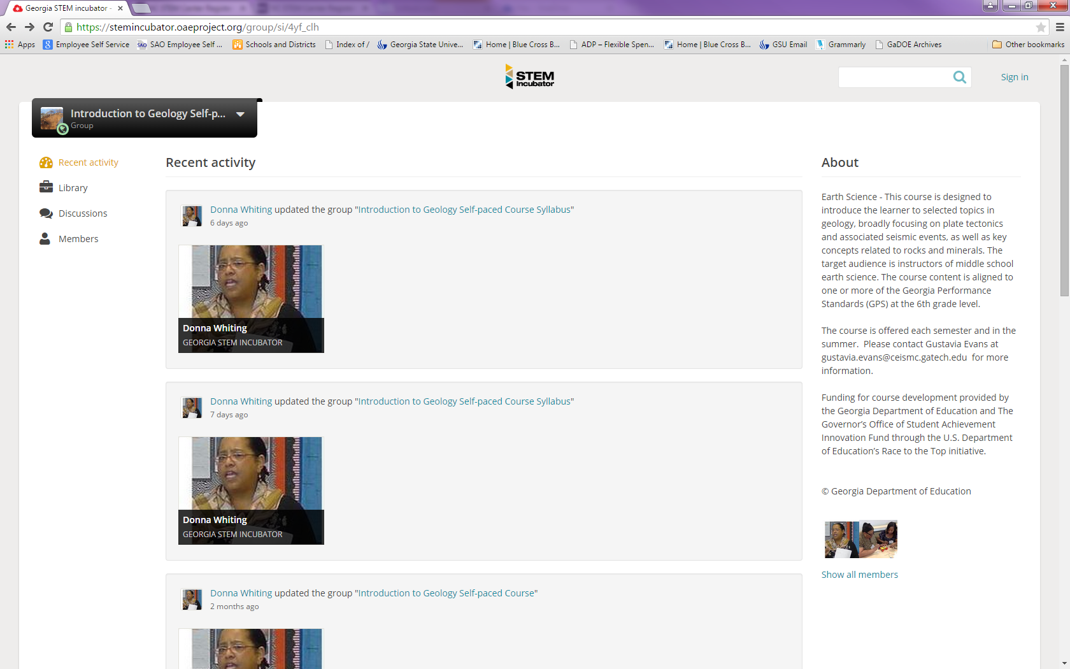
1.4 Navigate Home from OAE
HOME ICON
stemincubator.org

Slide 6
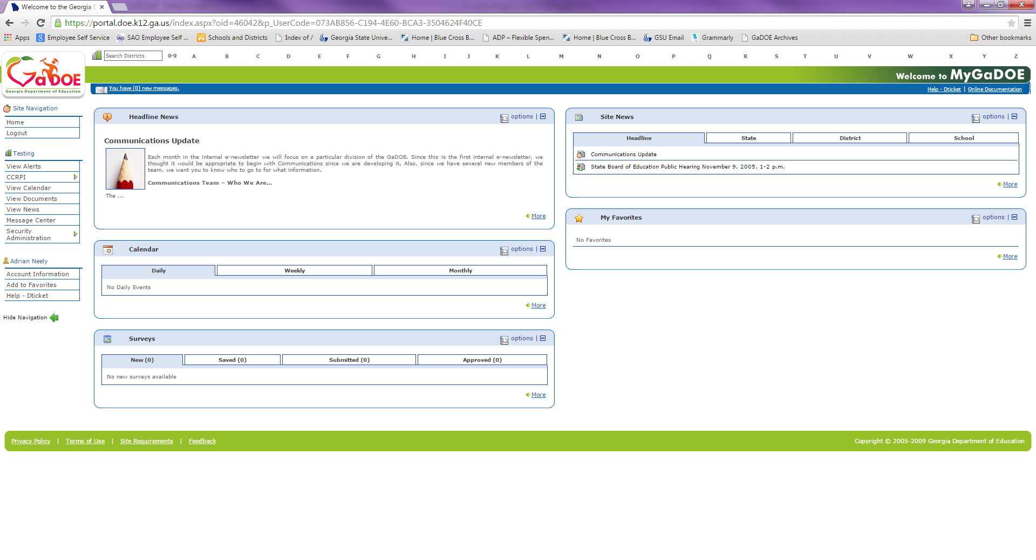
1.5 Dashboard capability

Slide 7
Discover and Connect to STEM resources, partners, and innovative initiatives through the Georgia Stem Incubator.
Georgia STEM Incubator
(Place logo here)
Login:
Register
Forgot Password?
Search this site…
Rotating Stock Photos & Georgia-Specific Photos
The movement to advance STEM education in Georgia is gaining momentum. The mission of the Georgia STEM Incubator) is to spur innovation in STEM education through reflective instructional practices, professional learning, and collaboration. Discover and connect to STEM resources and partners throughout the state.
Resources
Become a STEM Certified Schools
Partners
Learn More
Learn More
Learn More
Site Map Funded By Terms
Accessibility Sponsors Privacy Policy
Notes:
Option 1

Slide 8
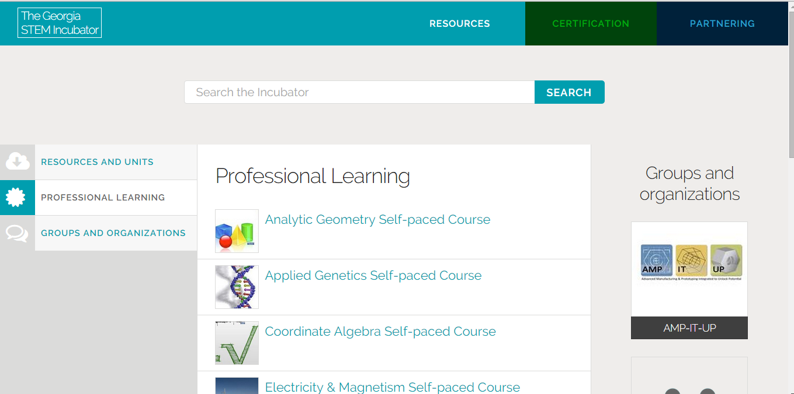

Add Designated User: Resources and Units, Professional Learning, and Groups and Organizations
DELETE
Refine your search by type:
Search Results:
Alphabetically | Just Added | Relevancy
Educators
A-D
E-L
Related to Search:
Etc.
Parents and Students
COMPETITIONS
STUDENT COURSES
SCHOLARSHIPS AND PROGRAM
STUDENT CAMPS
Icons
Notes:
A red dot or red text box is used to denote the requested change on an existing site page.

Slide 9
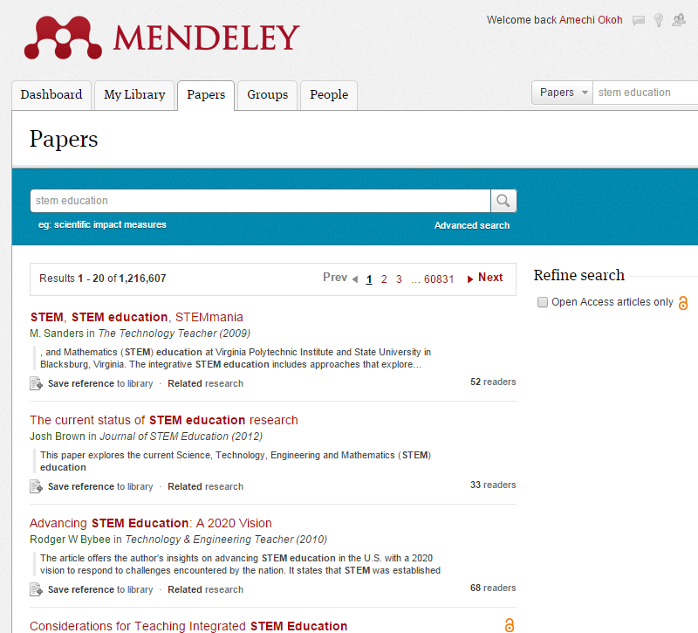
2.1 Mendeley Review

Slide 10
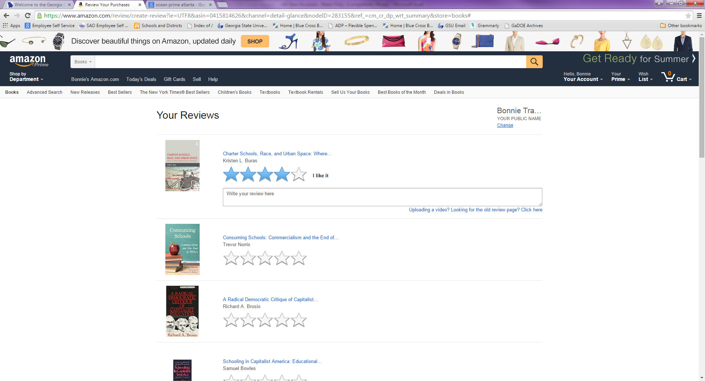
2.2 Amazon Review

Slide 11
Discover and Connect to STEM resources, partners, and innovative initiatives through the Georgia Stem Incubator.
Georgia STEM Incubator
(Place logo here)
Login:
Register
Forgot Password?
Search this site…
Rotating Stock Photos & Georgia-Specific Photos
The movement to advance STEM education in Georgia is gaining momentum. The mission of the Georgia STEM Incubator) is to spur innovation in STEM education through reflective instructional practices, professional learning, and collaboration. Discover and connect to STEM resources and partners throughout the state.
Resources
Become a STEM Certified Schools
Partners
Learn More
Learn More
Learn More
Site Map Funded By Terms
Accessibility Sponsors Privacy Policy
Notes:
Option 1

Slide 12
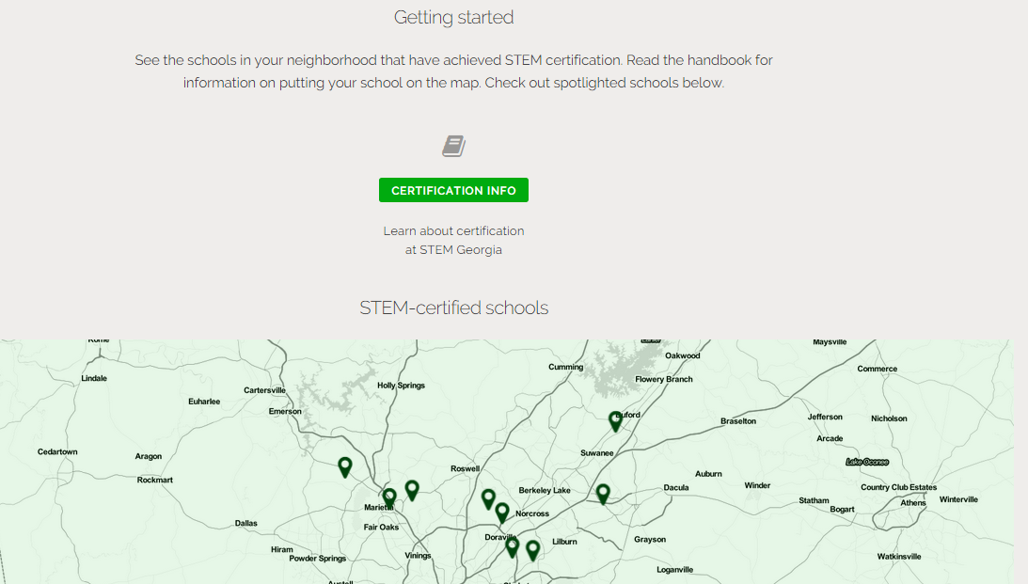
3.0 Certification Page: Downloadable file or list view of map spotlights
Hyperlink the certification info to the text. Text should read:
“Read the handbook for information on adding your school to the map. Check out the map below for spotlighted schools.”
*NOTE: Correct hyperlink so that viewer lands on step 1 of the roadmap
Remove

Slide 13
Discover and Connect to STEM resources, partners, and innovative initiatives through the Georgia Stem Incubator.
Georgia STEM Incubator
(Place logo here)
Login:
Register
Forgot Password?
Search this site…
Rotating Stock Photos & Georgia-Specific Photos
The movement to advance STEM education in Georgia is gaining momentum. The mission of the Georgia STEM Incubator) is to spur innovation in STEM education through reflective instructional practices, professional learning, and collaboration. Discover and connect to STEM resources and partners throughout the state.
Resources
Become a STEM Certified Schools
Partners
Learn More
Learn More
Learn More
Site Map Funded By Terms
Accessibility Sponsors Privacy Policy
Notes:
Option 1

Slide 14
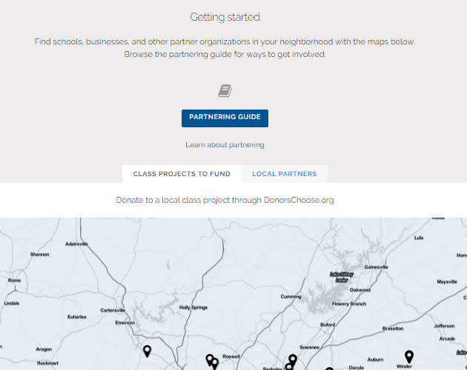
4.0 Partners Page: Downloadable file or list view of map spotlights
Get started now!
Create a new definition
Move the “Registration” and “handbook” resources to the right of the page. Registration should be partner specific.
Remove

Slide 15
Helpful Resources
STEM Georgia Website
http://stemgeorgia.org/why-stem/
Georgia Standards
https://www.georgiastandards.org/Common-Core/Pages/STEM Frameworks-of-Instruction.aspx
North Carolina STEM Center
https://www.ncstemcenter.org/

Slide 16


Formats of informational websites for review

